Slide 1
HOW TO USE 5 SERVICE PORTS
Evaporator
EV
CSV
Reheat Coil
TEV
BSV
RSV
DSV
HSV
ESV
Drier
Check valve
DPR
Condenser (Air)
LSV
SMV
Condenser
(Water)
②
ISV
Compressor
①
④
⑤
③
service port

Slide 2
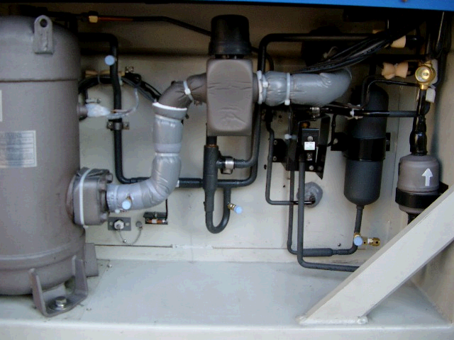
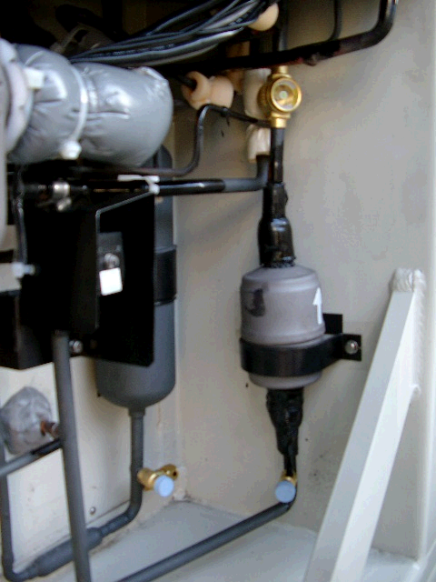
How to use 5 service ports LXE10E-A
Suction modulating valve
Liquid receiver
②
High
.
Compressor
Dryer
①
Low
④
Ｈｉｇｈ / Joint-Low
⑤
High
③
High
Service work |  | Service port | Remarks
Pressure check | High press. | ② | Take care that the high pressure at the port ④ & ⑤ will be keeping a while after the unit stops.
 | Low press. | ①
Refrigerant charge | 1.Refrigerant recovery | ④＆⑤ | Recover refrigerant from ④ & ⑤ after operating automatic pump-down first
 | 2.Vacuum & Dehydration | ④＆⑤ | After recovering, vacuum from port ④ & ⑤.
 | 3.Liquid charging | ⑤→③ | After vacuuming, charge liquid refrigerant from ⑤ first and the from ③.
 |  |  | If not reached to the specified amount, go to next below.
 |  | ③ | 1.Operate automatic pump-down first and stop it using ON/OFF switch when the compressor stops during the auto pump-down operation. 2.Charge liquid refrigerant from port ③.

Slide 3
OPERATION PRESSURE CHECK
②
①
LP HP

Slide 4
REFRIGERANT RECOVERING
④
⑤

Slide 5
VACUUM & DEHYDRATION
④
⑤
Vacuum Pump

Slide 6
REFRIGERANT CHARGING, STEP 1
⑤
R134a

Slide 7
REFRIGERANT CHARGING, STEP 2
③
R134a

Slide 8
REFRIGERANT CHARGING, STEP 3
1. Operate automatic pump down.
2. Stop the automatic pump down when compressor stops during the operation.
③
R134a

